Slide 1
Leadership
黄鹏升 Johnny Huang

Slide 2
Lead by example
You have to succeed so that others can realise their dreams!
-JR·RIDINGER

Slide 3
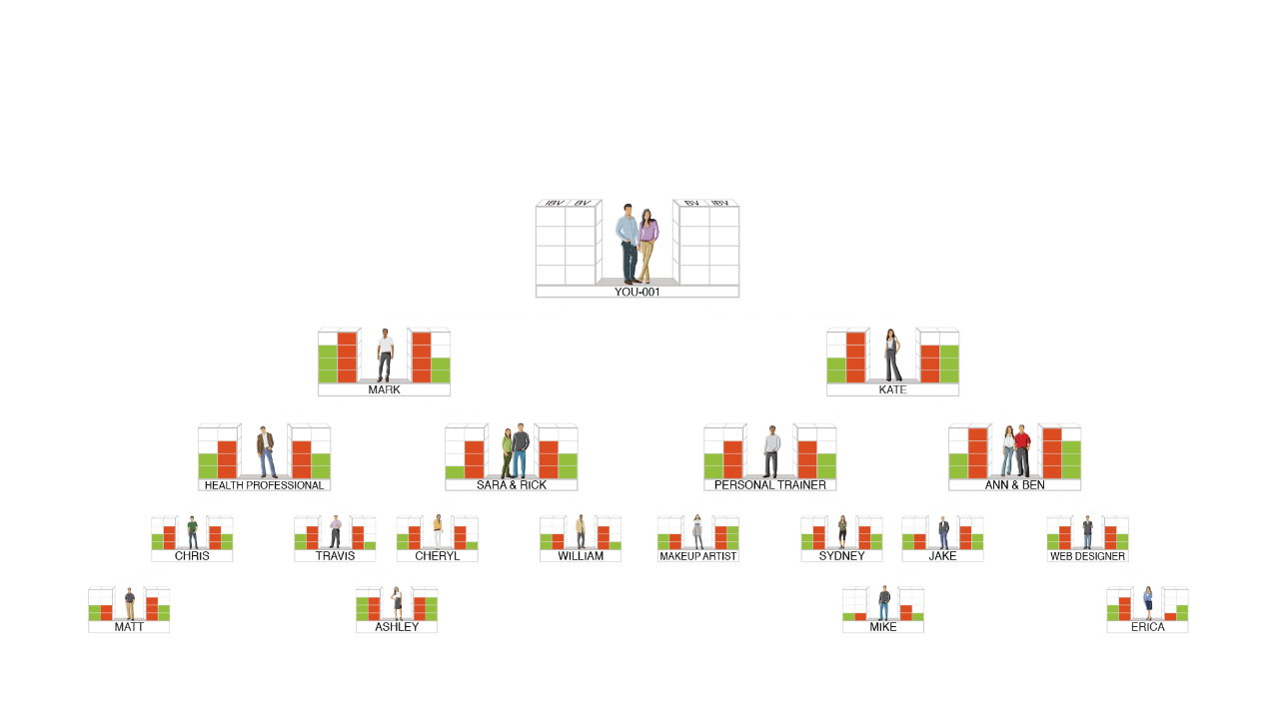
AS YOUR ORGANIZATION EXPANDS
THE FREQUENCY OF COMMISSIONS EARNED INCREASES UNTIL IT OCCURS WEEKLY
5000 / 5000 = S$750
3600 / 3600 = S$375
2400 / 2400 = S$375
1200 / 1200 = S$375
S$1,875
5000 / 5000 = S$750
3600 / 3600 = S$375
2400 / 2400 = S$375
1200 / 1200 = S$375
S$1,875
BV
5000
5000
IBV
3600
3600
2400
2400
1200
1200
TOTAL WEEKLY POTENTIAL S$3,750 PER BDC

Slide 4
2-3 years MA success plan
$ $ $ $ $ $ $ $ $ $ $ $ $ $ $ $ $
devotion
$ $ $ $ $ $ $ $ $ $ $ $
devotion
$ $ $ $ $ $ $
devotion
$ $
devotion
Notes:
4

Slide 5
The Importance of a Leader…
Typical business or enterprise:
One needs to work all the time to earn residual income
MA SHOP.COM™:
Earn residual income without having to work all the time

Slide 6
BV+BV = Residual Income
Leader + Leader = Residual income

Slide 7
IT IS EASY TO HAVE A THOUSAND SOLDIERS
BUT HARD TO FIND A GOOD GENERAL

Slide 8
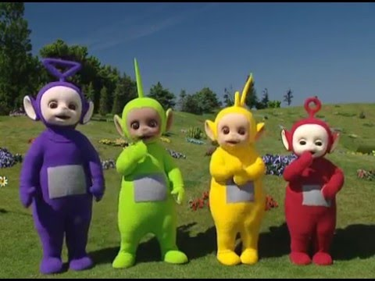

Slide 9
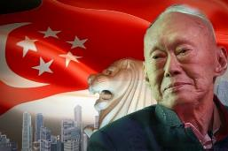

Slide 11
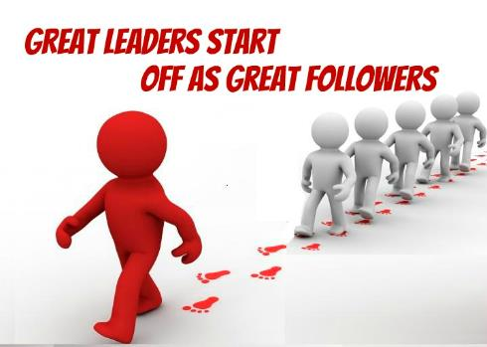
prerequisite for Being a MA leader
Start off by being a good follower? You have to lead yourself before you lead others? Earn trust and respect

Slide 12
Learning --> prepare yourself

Slide 13
The Traits of a Leader:
1. Unshakable courage based on understanding of yourself and your profession
2.Self control
3.Acute sense of justice
4. Quick and smart decision
5. Clear plan
6. The habit of working beyond pay grade
7. Easy-going characteristic
8. Sympathy and understanding
9. Proficient in all details
10. Accountability
11. Cooperation

Slide 14
WHO’S TAKING OVER?

Slide 15
HOW DO WE PRODUCE A LEADER?
1. Natural occurring
2. Assignment
1. The team set medium-long term plan 2. Inform that he will be cultivated 3. Assign tasks to him 4. Medium-long term tasks schedule

Slide 16
GOLDEN CIRCLE THEORY
WHAT
How
WHY

Slide 17
IF YOUR ‘WHY’ AND THE ‘WHY’ OF THE UNFRANCHISE® SYSTEM IS THE SAME
WHAT
WHAT
WHY
HOW
HOW
WHY
UnFranchise® Golden Circle and The WHY
Your Golden Circle and
The WHY

Slide 18
The HOW of the company
When your WHY overlaps, merges or become one with the WHY of the company, what will happen?
Your HOW
Your WHAT
Your WHY

Slide 19
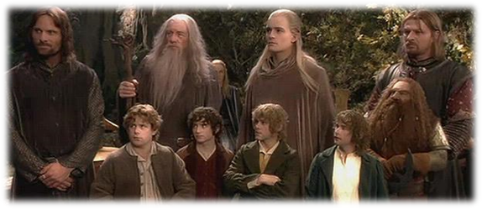
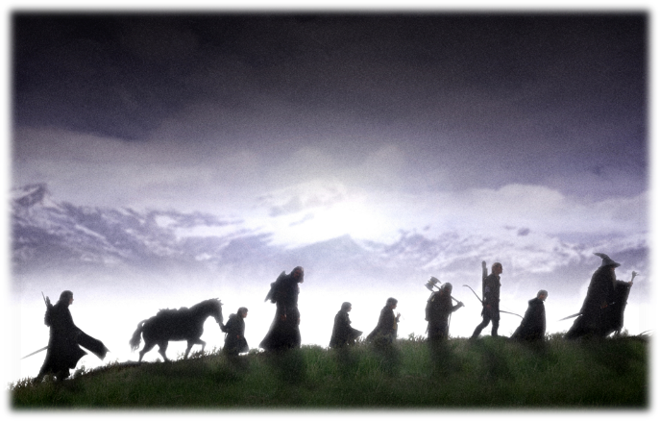
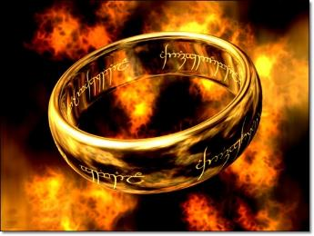

Slide 20
Leader
TERMINATOR OF PROBLEMS
pattern
moral
habit
leader

Slide 21
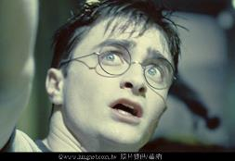
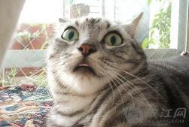
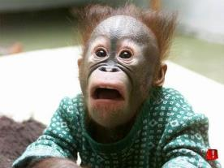
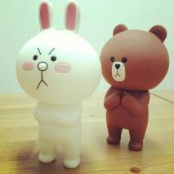
EVENT OCCURRENCE…
Establish camaraderie
Confirm your values

Slide 22
Everything happens for a reason
You either gain something or learn something

Slide 23
Identify the sacrifices or obstacles
to be overcome to achieve the goal
Mental Obstacle
Care about others’ opinion,
stage fright and afraid of failure.
Time Management Obstacle
Family, work, leisure, social duty,
church responsibility etc.
Financial Obstacle
Training fee, travel expenses,
business support materials and tools etc.

Slide 24
LEADERSHIP MANAGEMENT
﹥

Slide 25
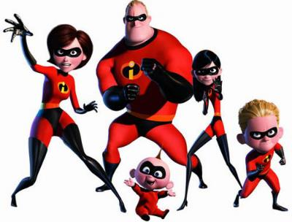
REAL PARTNERSHIP:
Is closer than relatives…
Second to family!!

Slide 26
There’s no perfect individual Only perfect organisation

Slide 27
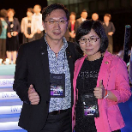
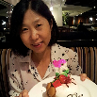
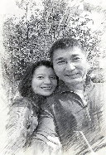
National Supervising Coordinator
Director
Lo Yin Yi
Lin Yu Shi
Huang Shi Hua
Huang Yin Yi
Wu Hui Rong
Michelle
Pan Jing Yun &
Huang Lin Xiang
Peng Guo Ding
Lin Shu Ting
Huang Zhi Lun
Feng Chun Hui
Executive Supervising Coordinator
Supervising Coordinator
Wang Xu Feng
Xu Da Diao
Shi Guo Ping
Huang Yan Kai
Yang Li Bin &
Guo Ya Fang
Cai Chang Zhi &
Lin Meng Han
Li Cheng Jia
Hu Sheng Hong
Yang Hui Yin
Huang Ying Qiao

Slide 28
If you want to go fast, go alone
If you want to go far, go together

Slide 29
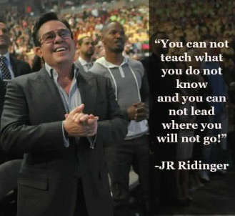
Lead by example
You have to succeed
so that others can realize their dreams!

Slide 30
Leadership
黄鹏升 Johnny Huang

